Slide 1
Electrical Circuits Power Calculation

Slide 2
Independent Power Sources
An ideal independent source is an active element that provides a specified voltage or current that is completely independent of other circuit elements.
An active element is one that can generate energy
A passive element is one that cannot generate energy

Slide 3
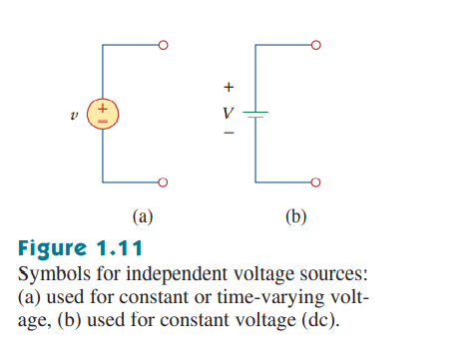
Independent Voltage Sources
Independent Voltage Sources provide a specified amount of voltage, irrespective of other circuit parameters
It provides necessary amount of current to the circuit to maintain its voltage supply

Slide 4
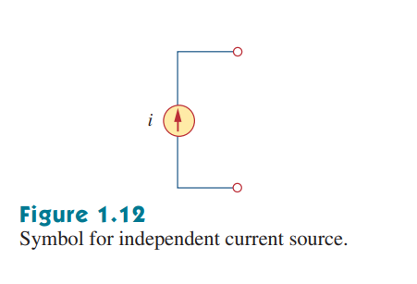
Independent Current Source
Provides a specific amount of current to the circuit
It maintains necessary voltage to provide the specified amount of current

Slide 5
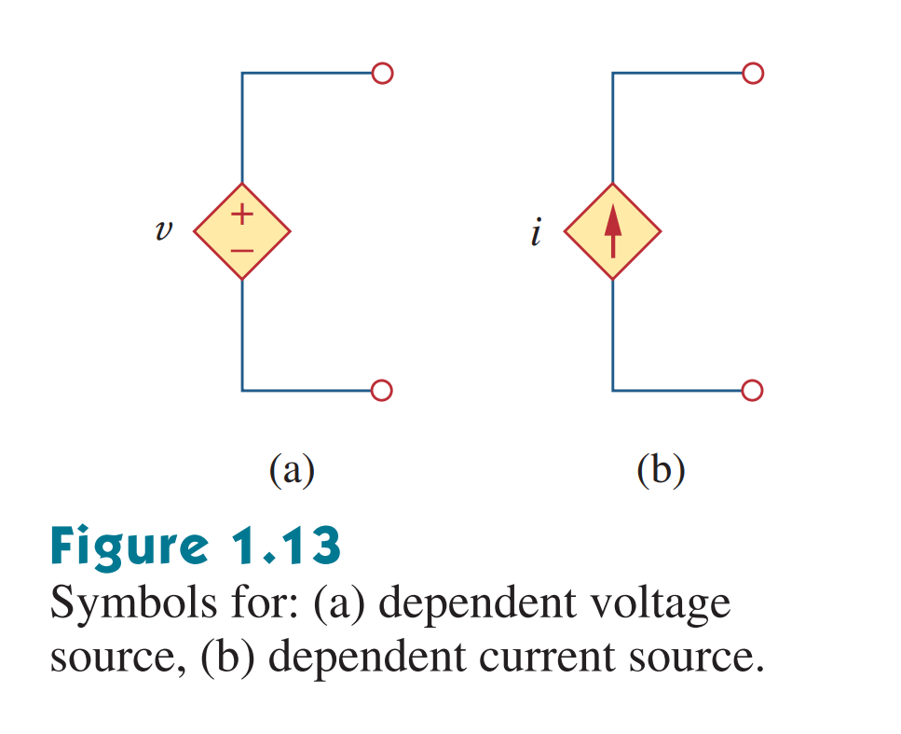
Dependent Source
An ideal dependent (or controlled) source is an active element in which the source quantity is controlled by another voltage or current.

Slide 6
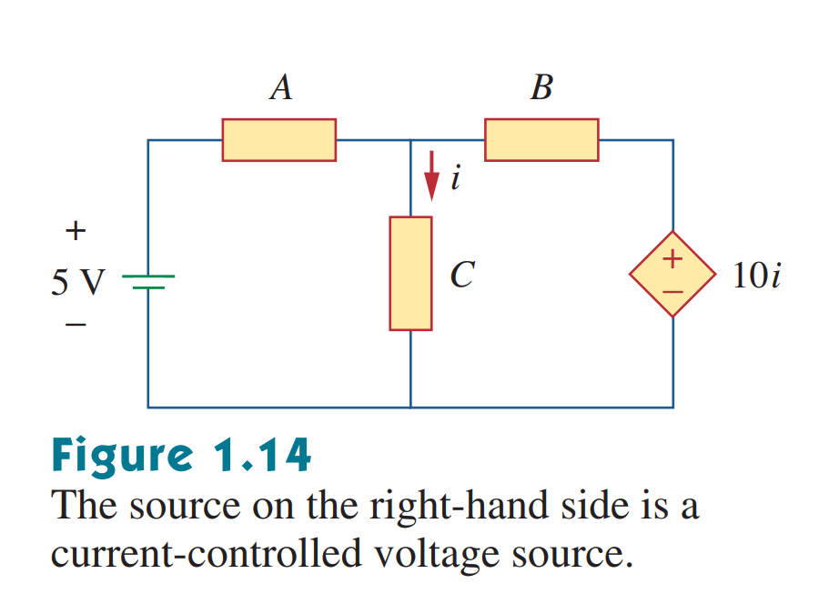
Example of a dependent source
The source on the right is:
A dependent source (It is in a diamond shape)
A voltage source (It has +/- terminals marked on it)
The value on its label (10i) is the voltage of the source, and not the current (Since it is a voltage source)
The source depends on the current of the middle branch (i). So, it is a current controlled source.

Slide 7

Types of Dependent Sources
There are four possible types of dependent sources, namely:
A voltage-controlled voltage source (VCVS).
A current-controlled voltage source (CCVS).
A voltage-controlled current source (VCCS).
A current-controlled current source (CCCS).

Slide 8
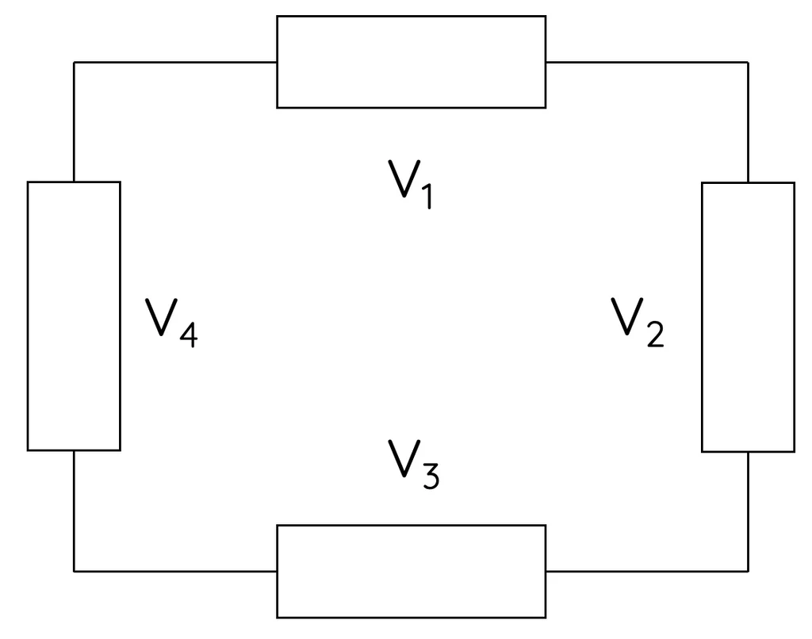
Kirchhoff's Voltage Law
Kirchhoff's Voltage Law states that the sum of all the electrical potential differences around any closed network (loop) is zero. This is because a charge going around a complete loop in a circuit must return to its original potential energy level by the time it completes the loop.
∑V=0
V1+V2+V3+V4=0

Slide 9
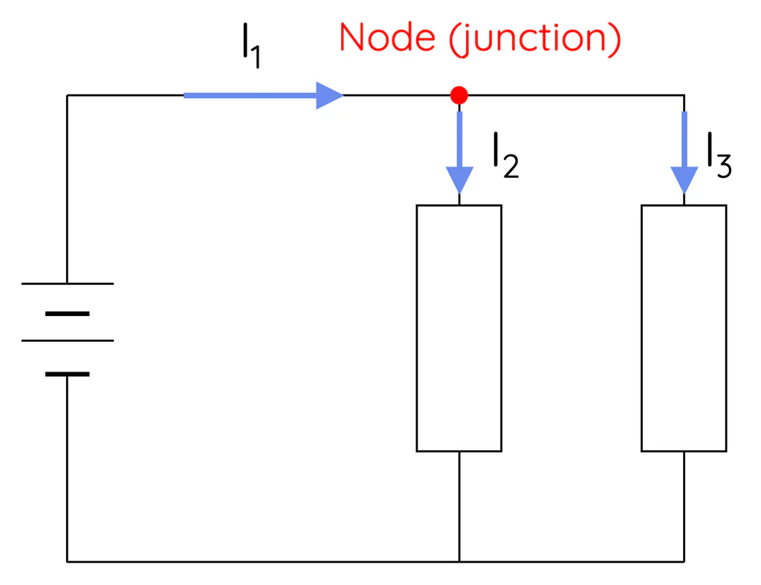
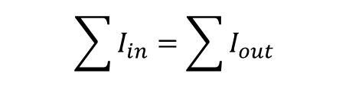
Kirchhoff's Current Law
Kirchhoff's current law states that the total current entering a junction (or node) in an electric circuit must equal the total current leaving the junction. This law is based on the principle of charge conservation; charge can neither be created nor destroyed. Therefore, whatever charge flows into the junction must flow out.
$$\sum{I_{in}}=\sum{I_{out}}$$

Slide 10
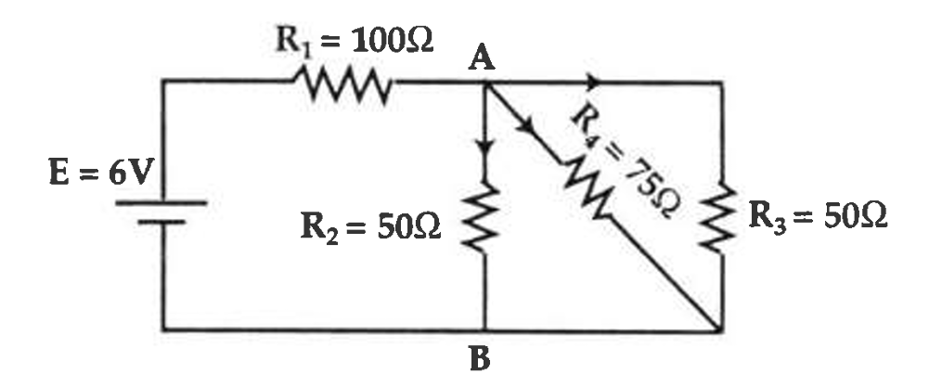
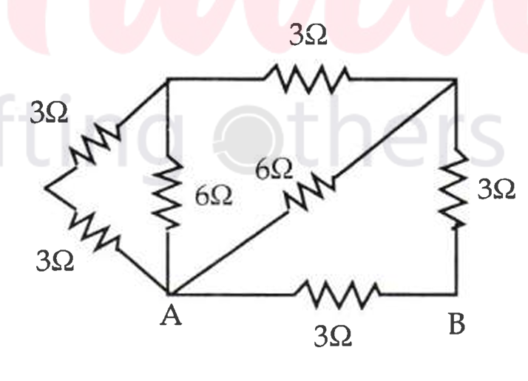
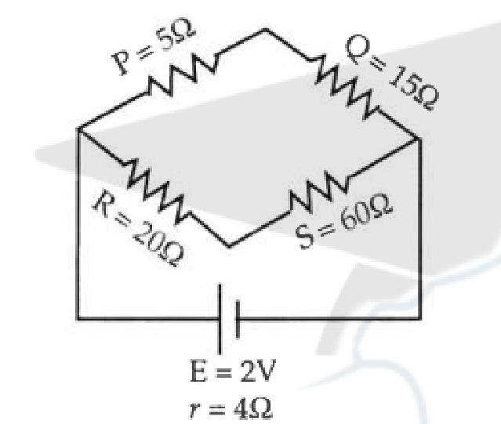
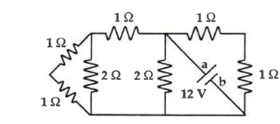

Slide 11
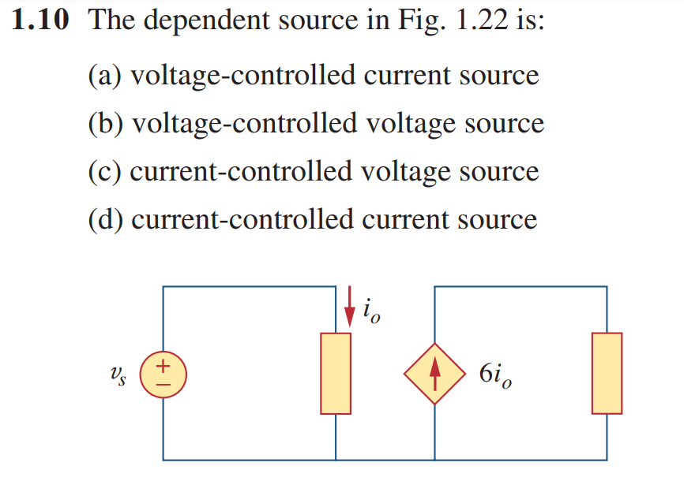
Types of Dependent Sources

Slide 12
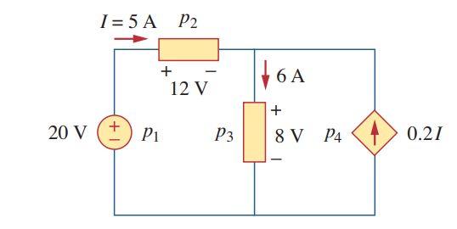
Math Problem Practice:
Calculate the power supplied or absorbed by each element:

Slide 13
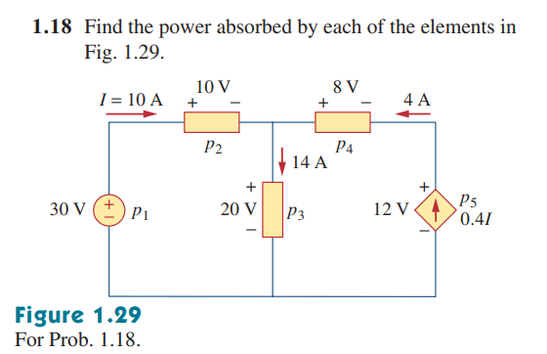
Math Problem Practice:

Slide 14
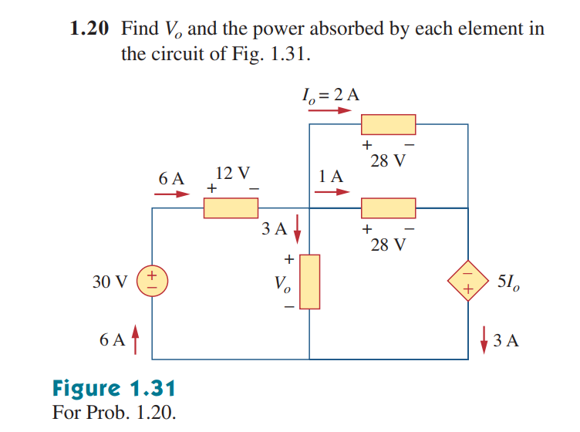
Math Problem Practice:

